Slide 1
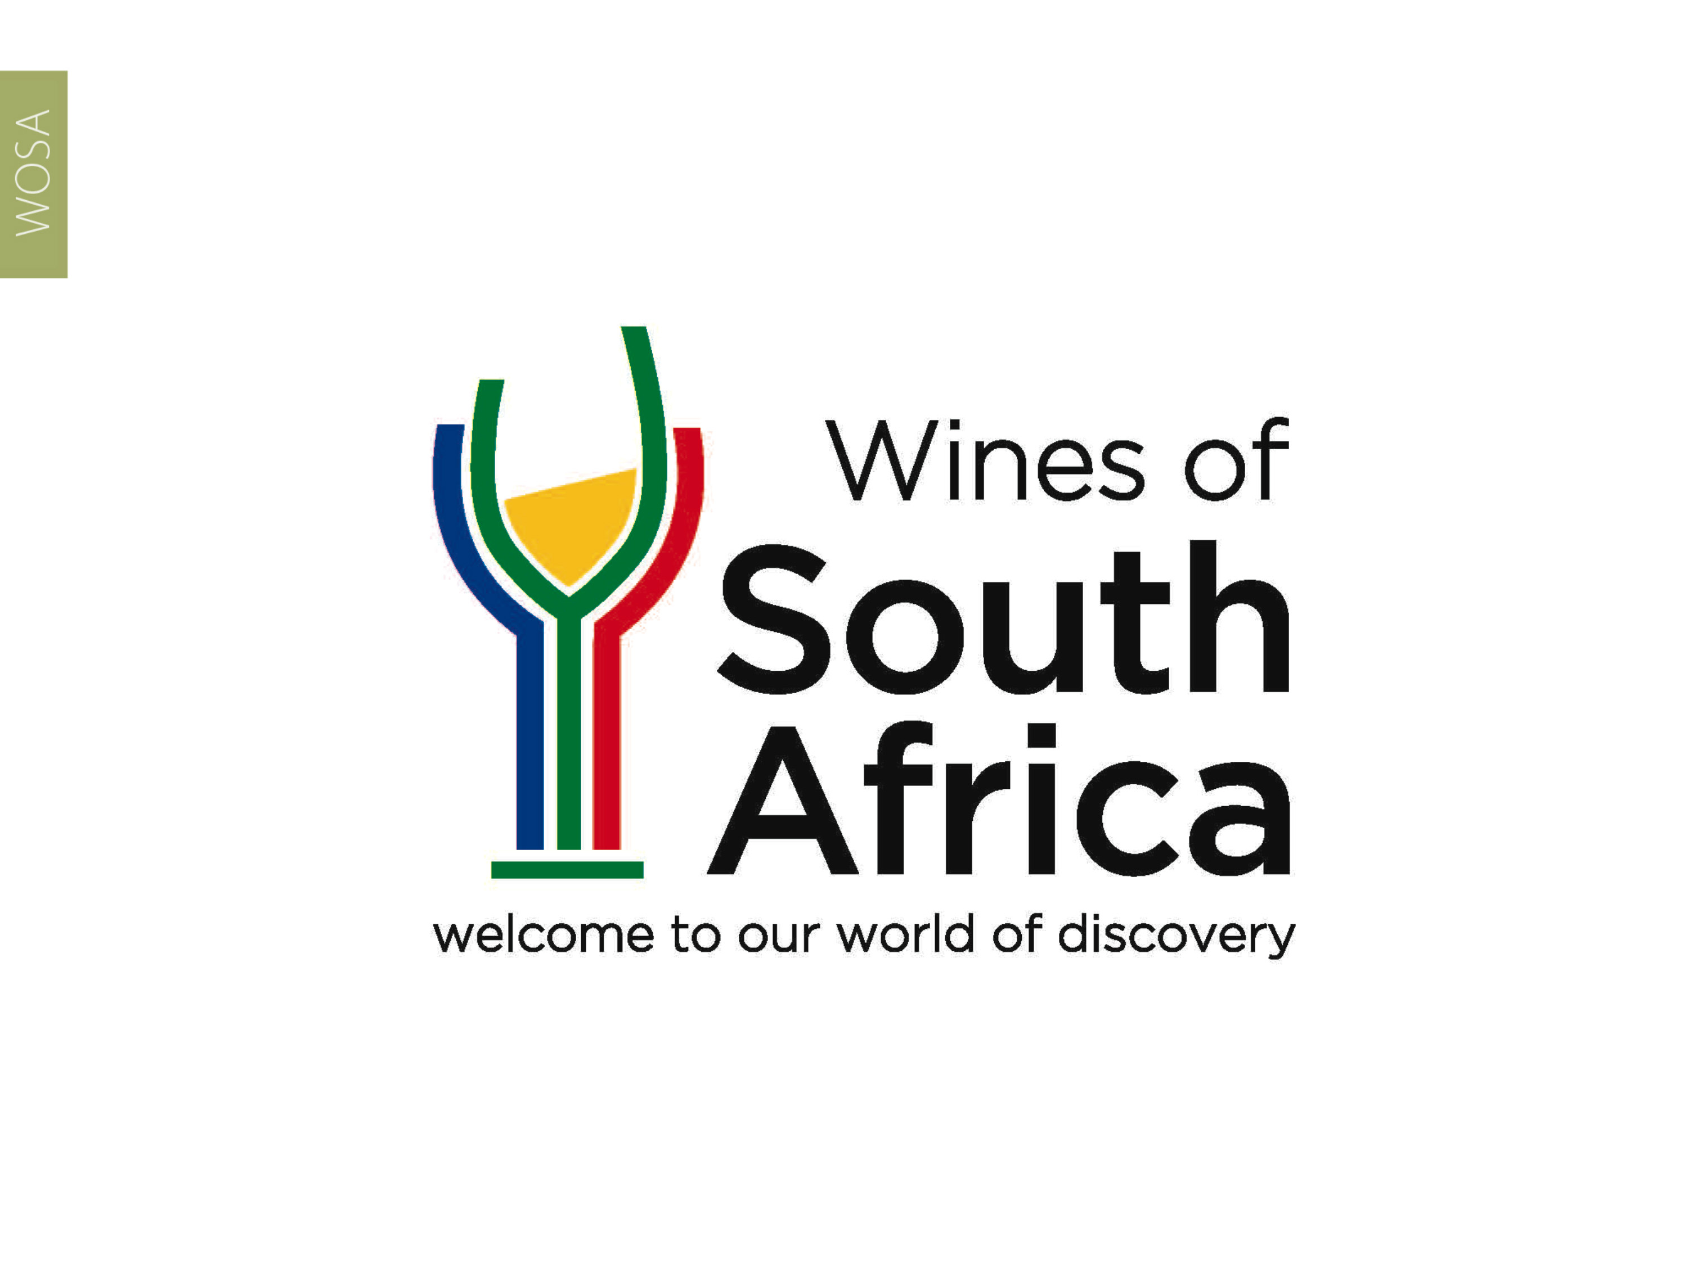
CAPE WINELANDS
KLEIN KAROO

Slide 2
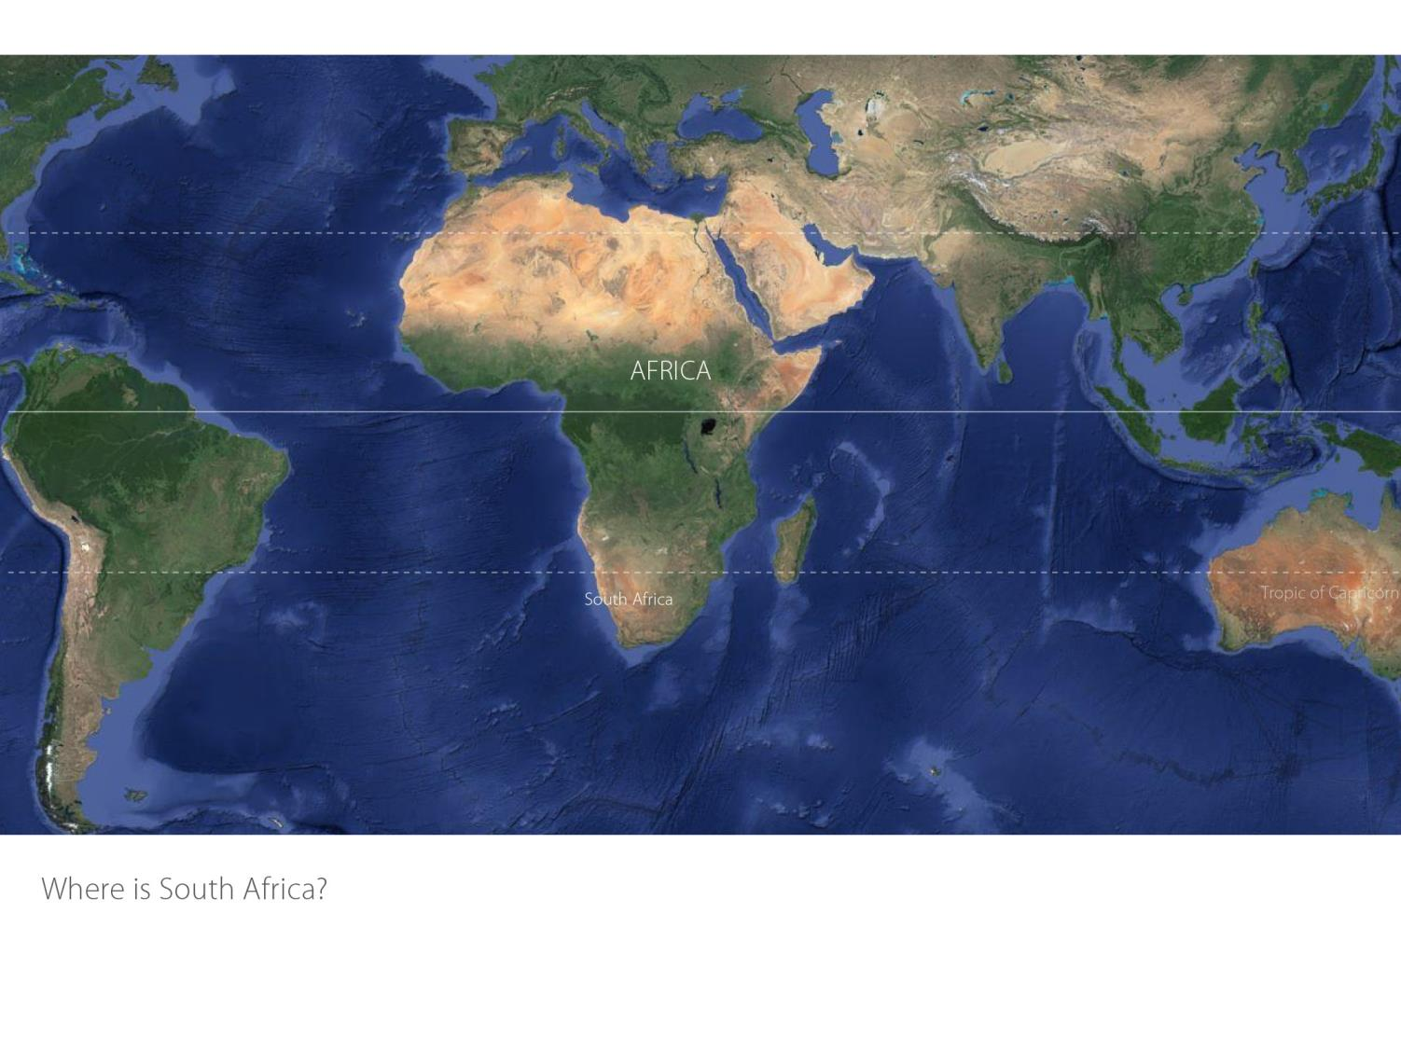

Slide 3
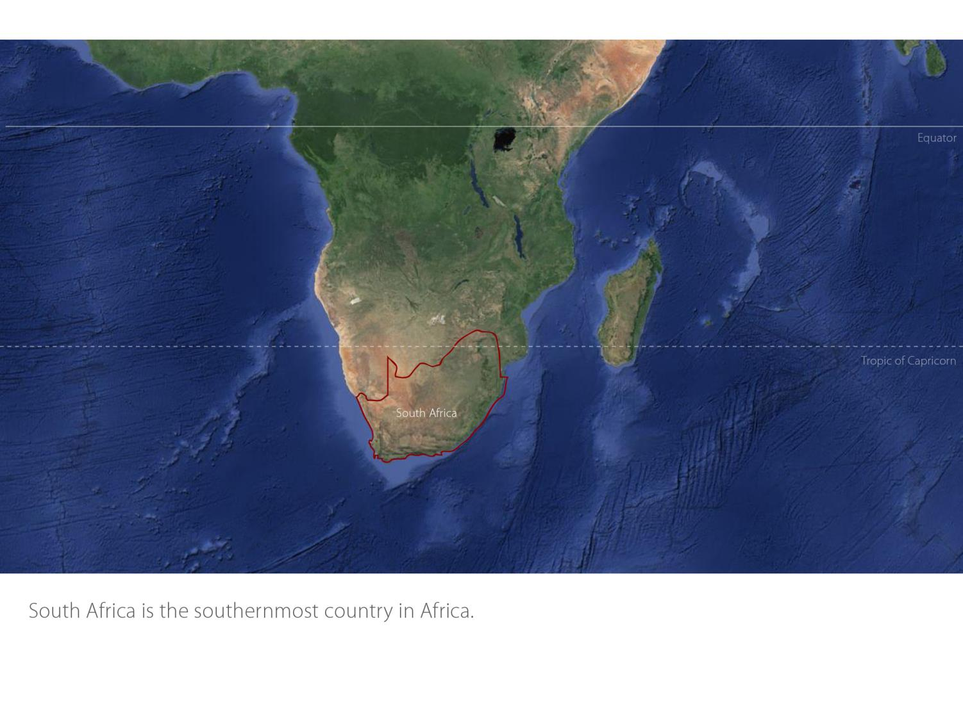

Slide 4
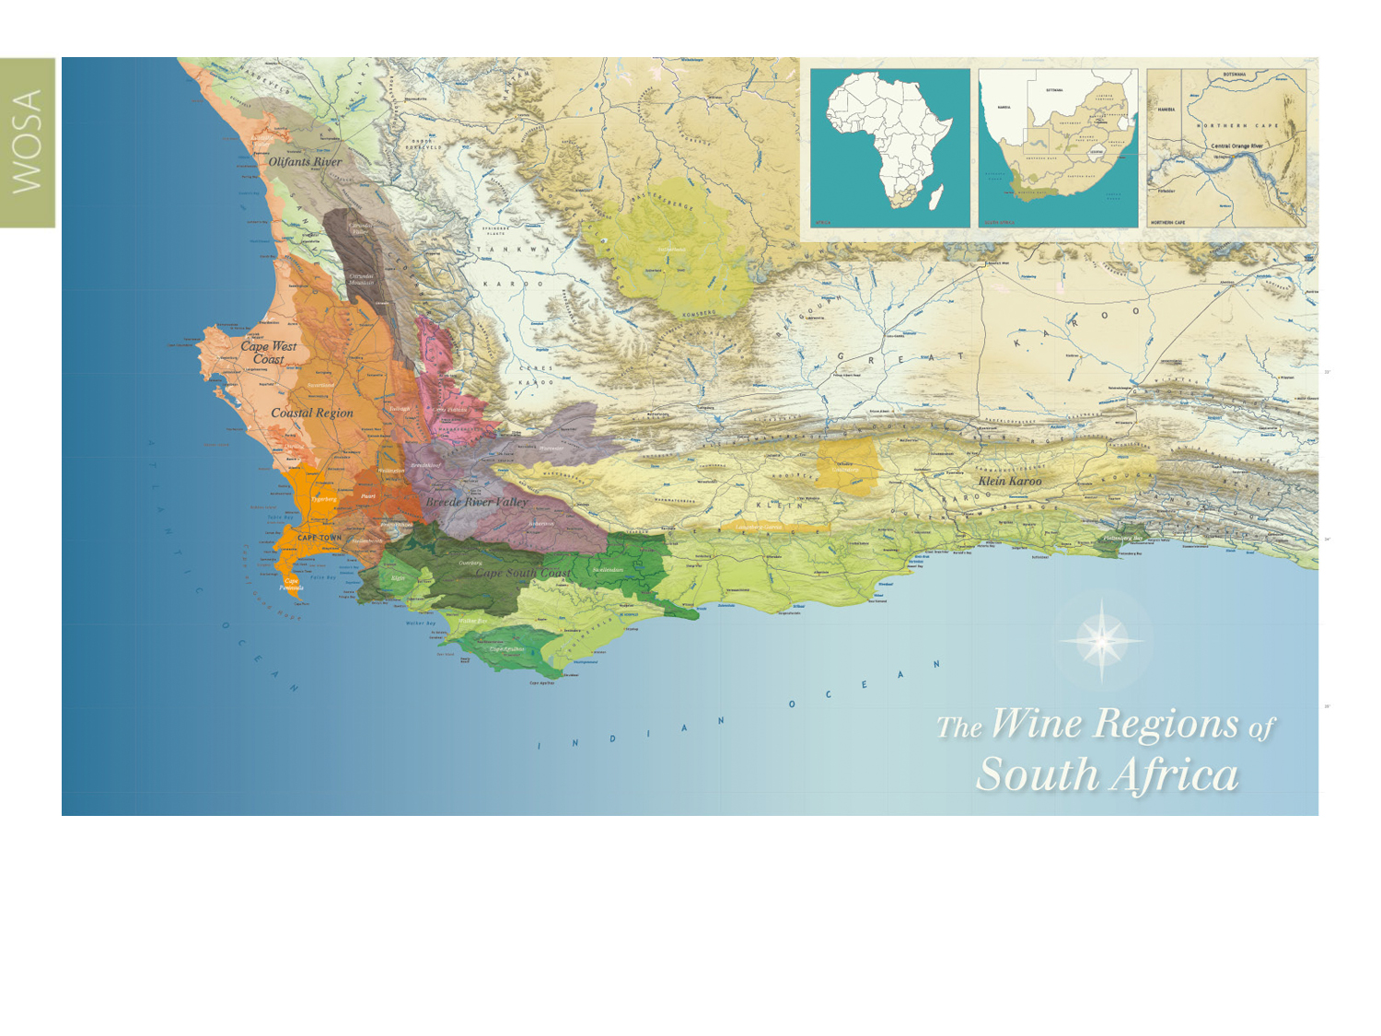
Our winelands are located at the very tip of South Africa.
Klein Karoo

Slide 5
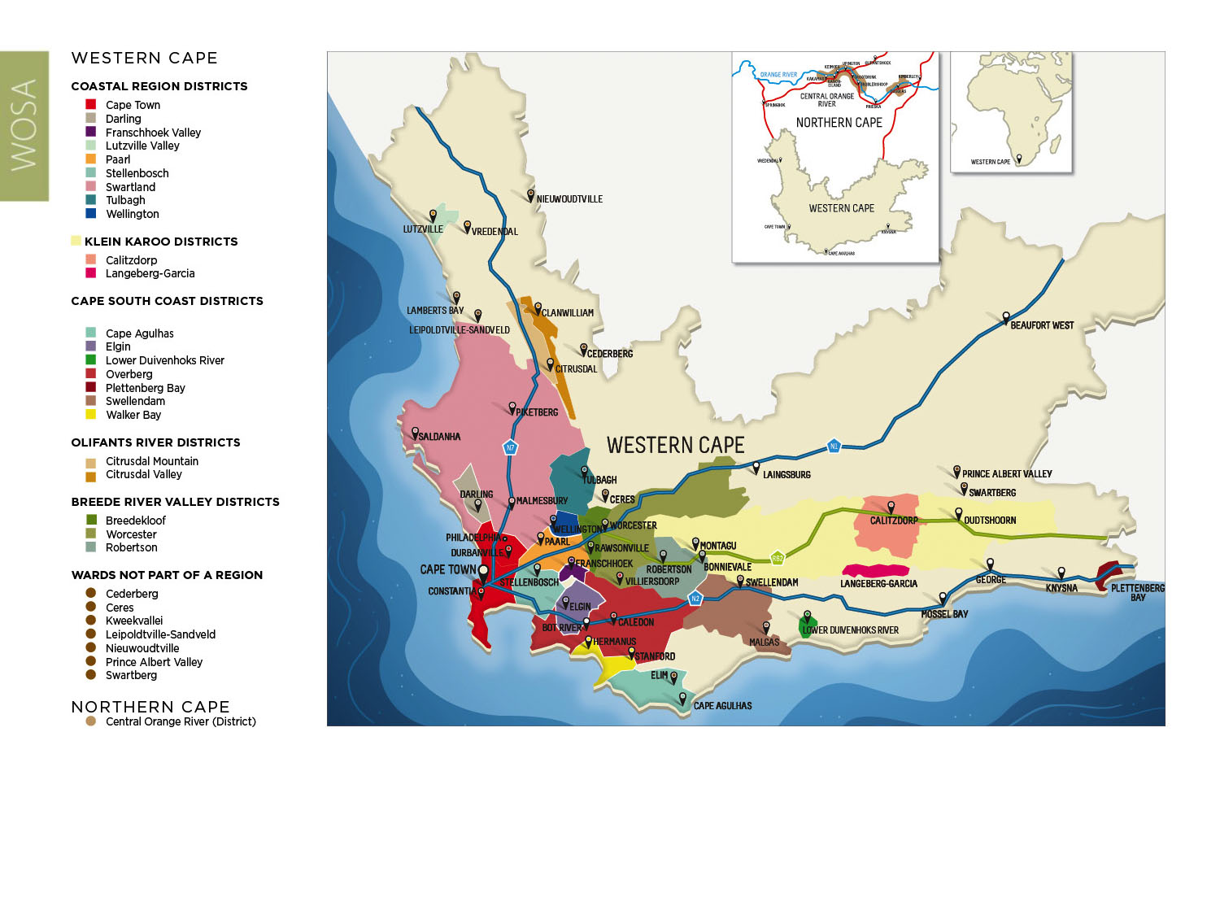
PRODUCTION AREAS: Districts of South Africa.
Klein Karoo

Slide 6
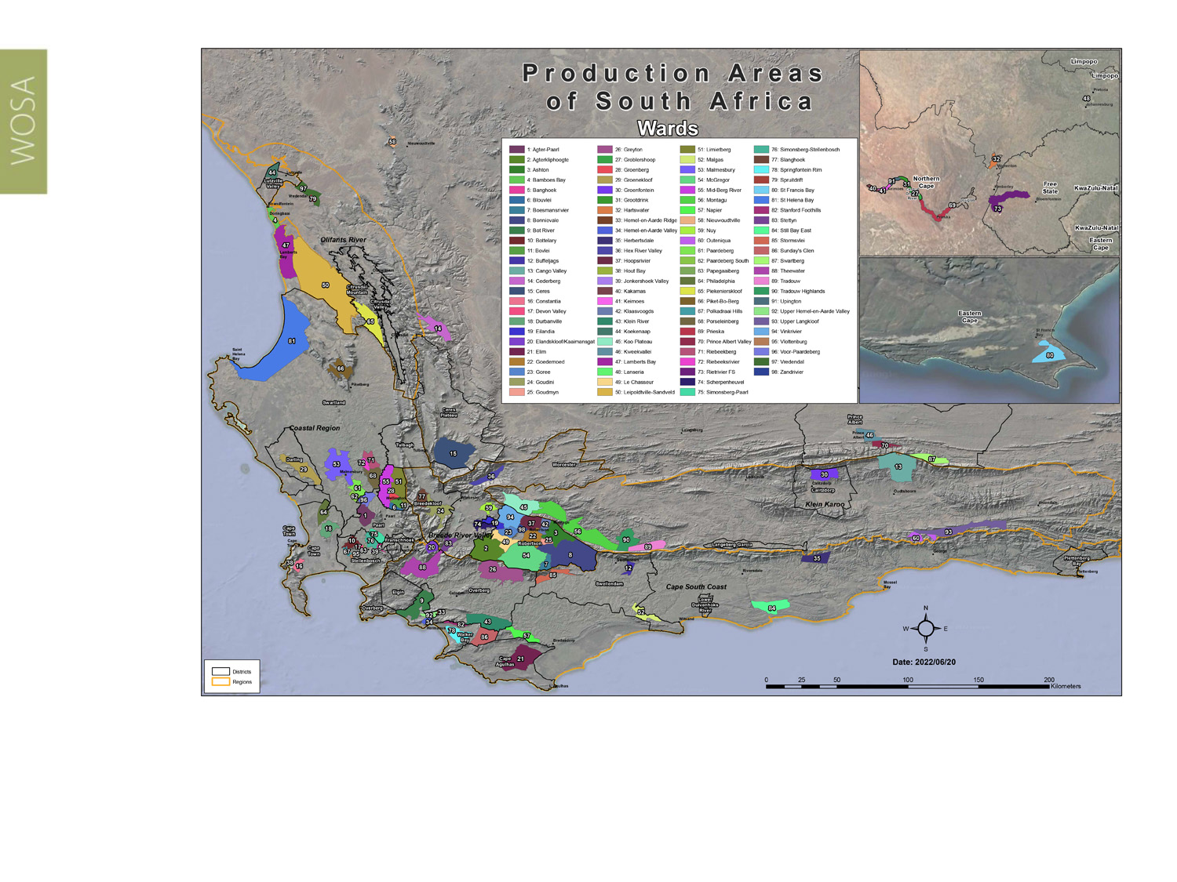
Wards of South Africa.
Klein Karoo

Slide 7
Klein Karoo
Region: Klein Karoo
Districts: Calitzdorp
Langeberg-Garcia
Wards: Cango Valley
Groenfontein
Koo Plateau
Montagu
Outeniqua
Tradouw
Tradouw Highlands
Upper Langkloof
Klein Karoo

Slide 8
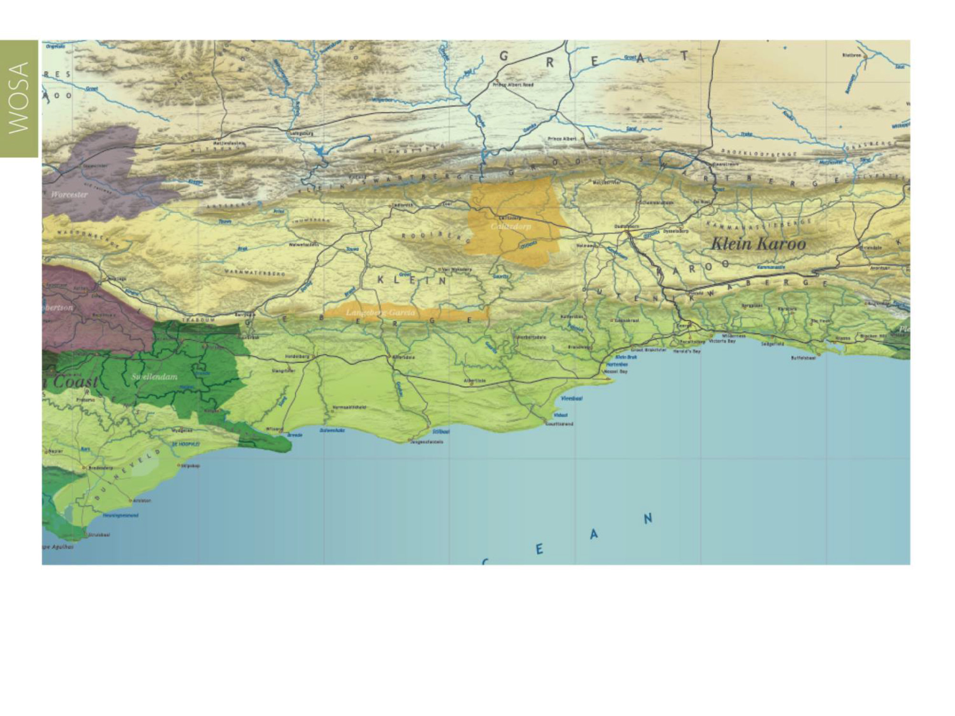
The 300 km long Klein Karoo region stretches all along the well-known R62 scenic route, from Montagu via higher-lying, cooler Barrydale towards Calitzdorp, Ladismith, Oudtshoorn and Herold in the Outeniqua mountains, making it the longest wine route in South Africa.
Klein Karoo

Slide 9
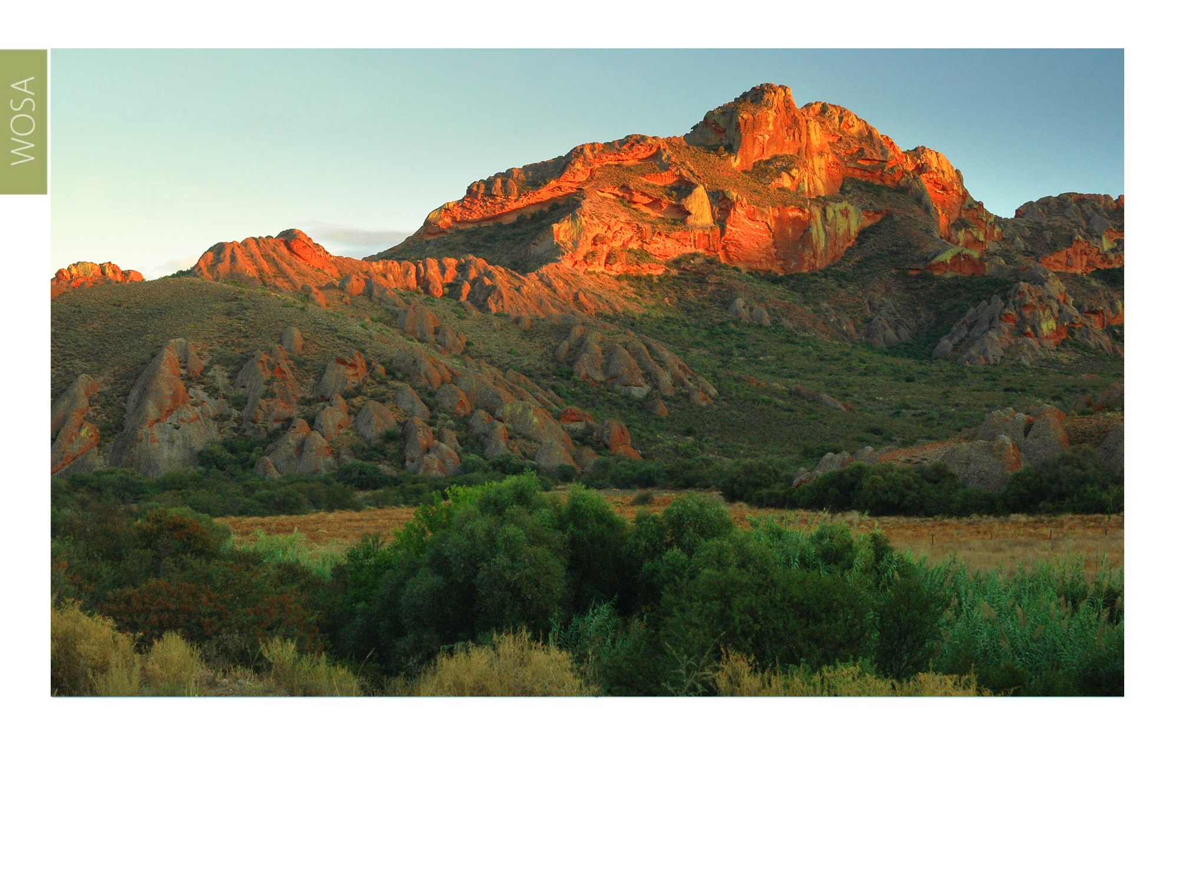
The Klein Karoo region is a unique and exceptionally diverse part of the Succulent Karoo Biome, encompassing diverging landscapes, climate, soils, flora and fauna.
Klein Karoo

Slide 10
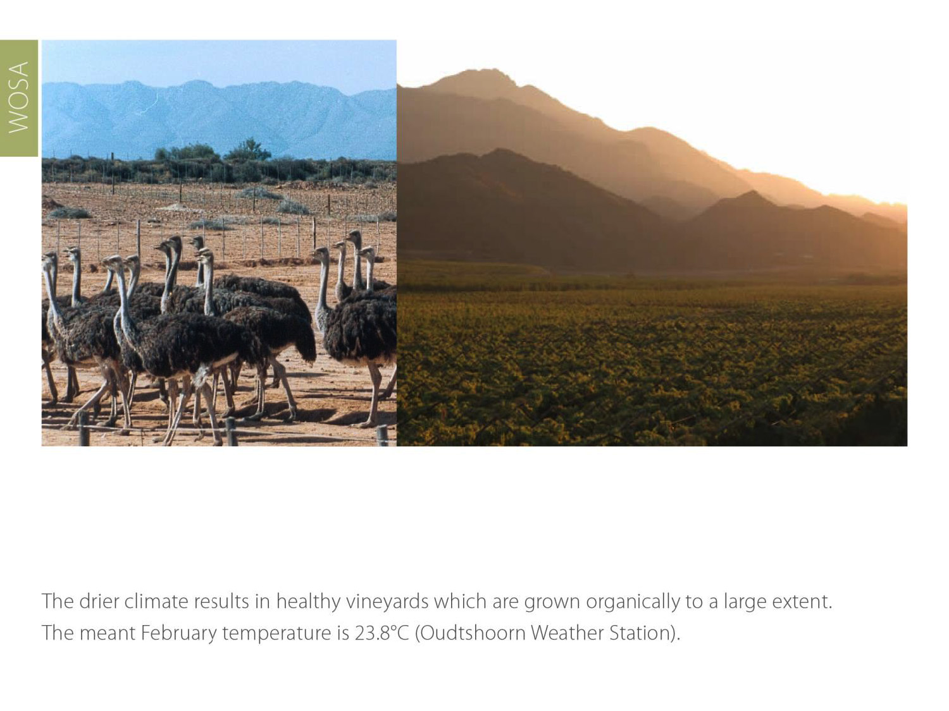
The drier climate results in healthy vineyards which are grown organically to a large extent. The mean February temperature is 23.1⁰C (Montagu) and the rainfall averages 200 mm per year.
Klein Karoo

Slide 11
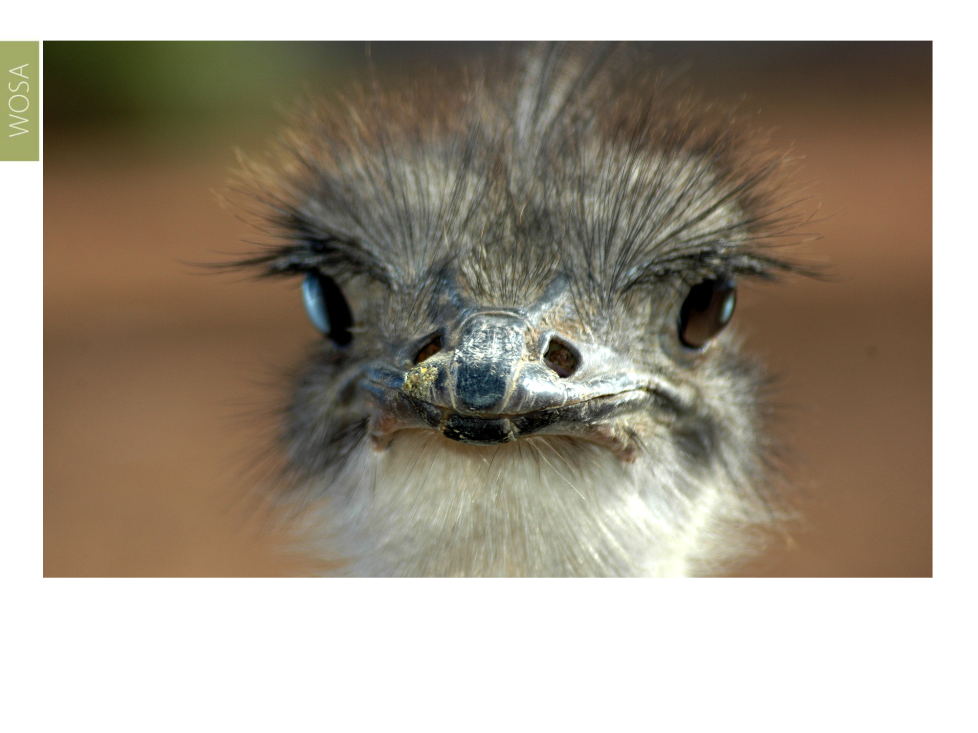
The Klein Karoo is first and foremost an agricultural region. Regional products are diverse and include the production of hops (80% of the total South African production), ostrich-related products (77% of the country’s total production) and fruit.
Klein Karoo

Slide 12
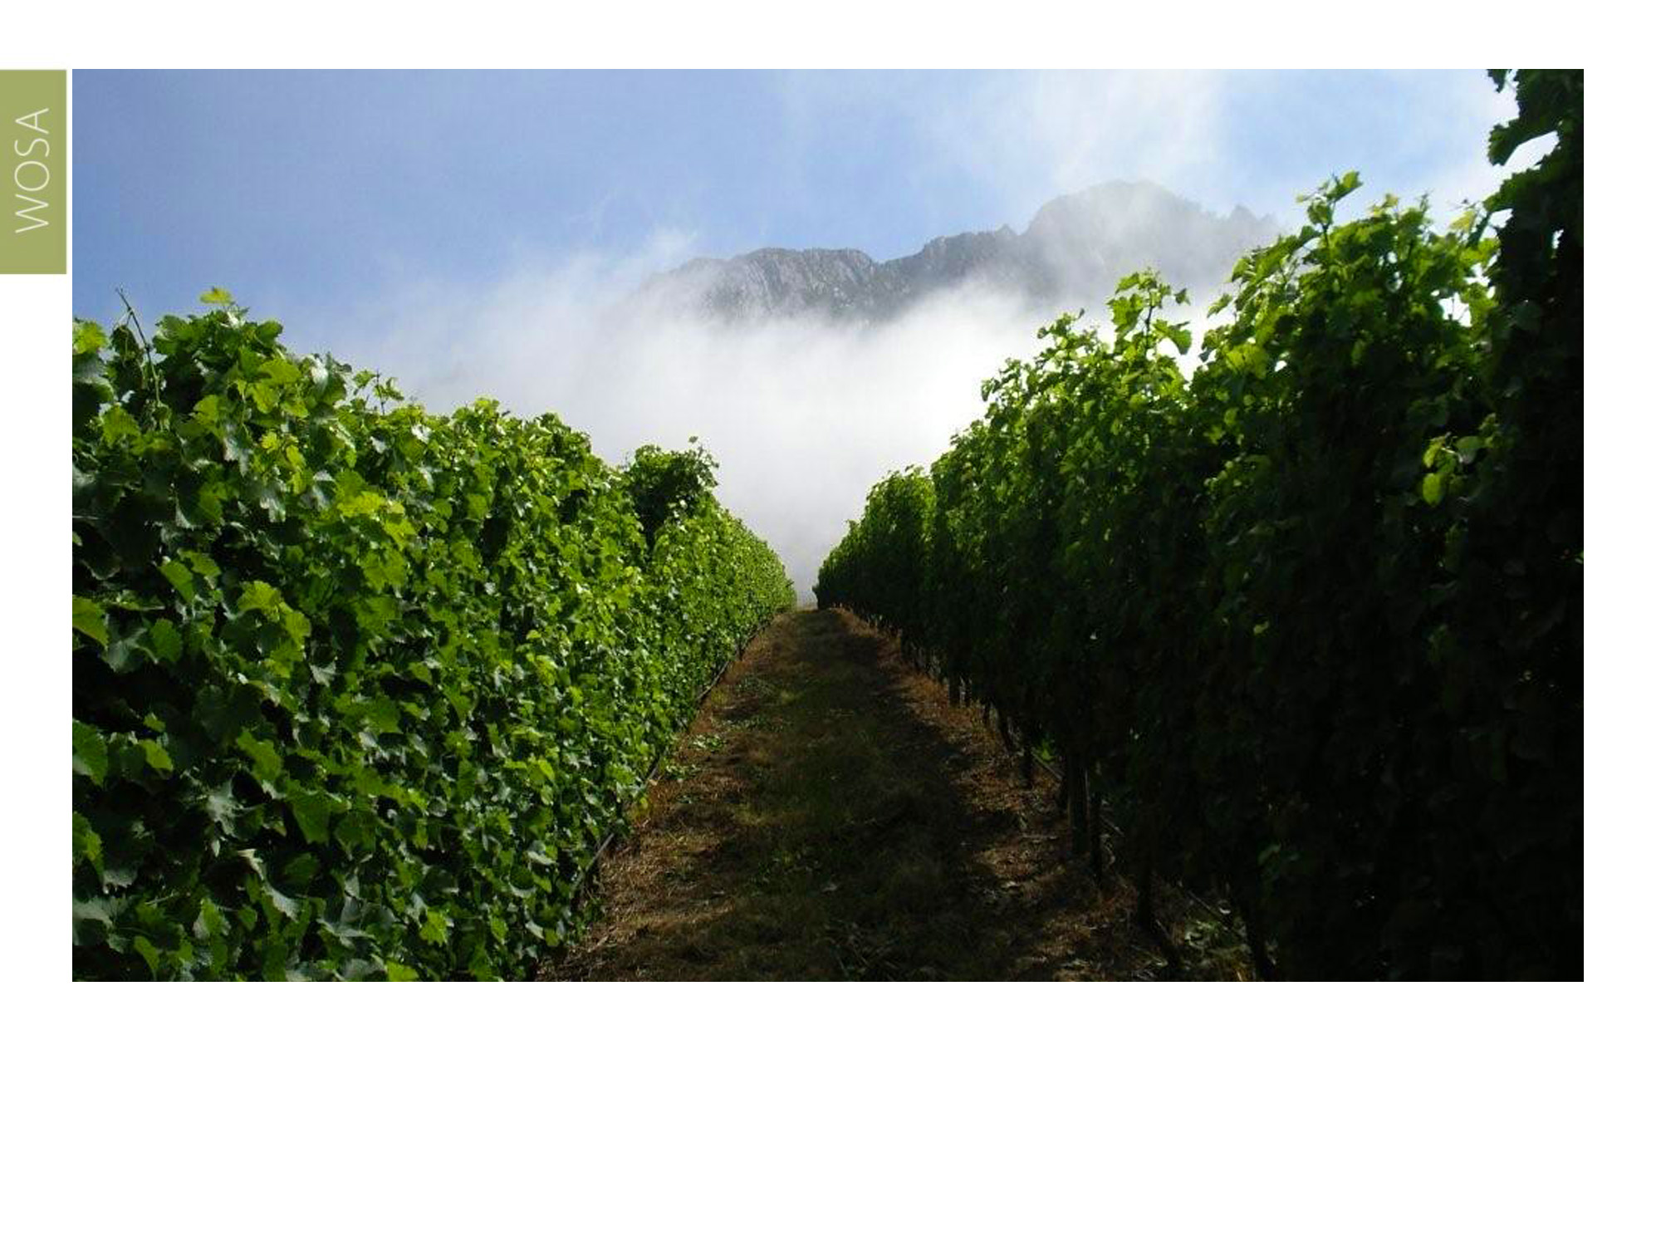
There are only 1 988 hectares of vines in the Klein Karoo, comprising 21% red-wine and 79% white-wine grape varieties. The Klein Karoo yields approximately 27 169 tons of grapes and produces 18 million litres of wine per year, just 2.3% of the country’s total wine production.
Klein Karoo

Slide 13
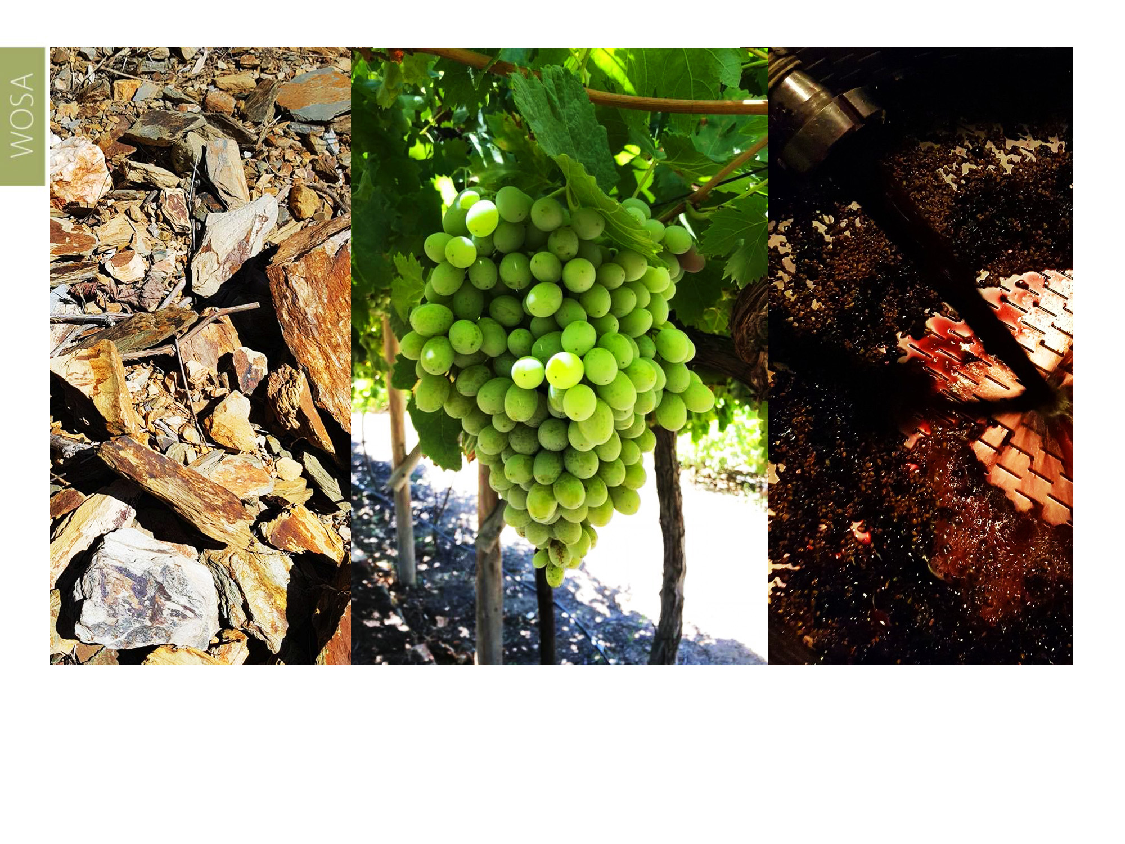
This area is known for relative extremes when it comes to soil and climate, resulting in diverse terroir and an exciting selection of different wine styles.
There are only 1 988 hectares of vines in the Klein Karoo, comprising 21% red-wine and 79% white-wine grape varieties. The Klein Karoo yields approximately 27 169 tons of grapes and produces 18 million litres of wine per year, just 2.3% of the country’s total wine production.
Klein Karoo

Slide 14
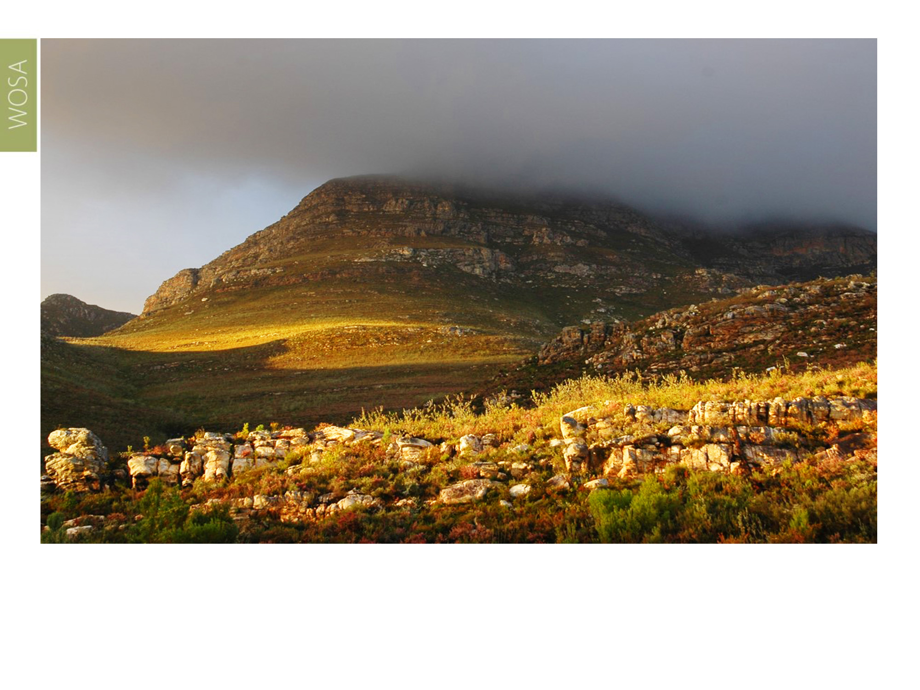
It is interesting to note that some of the highest mountain peaks in the Western Cape enclose this region. Winter rains and snow form an important part in the life cycle of the vineyard, and the region has great potential for growth.
Klein Karoo

Slide 15
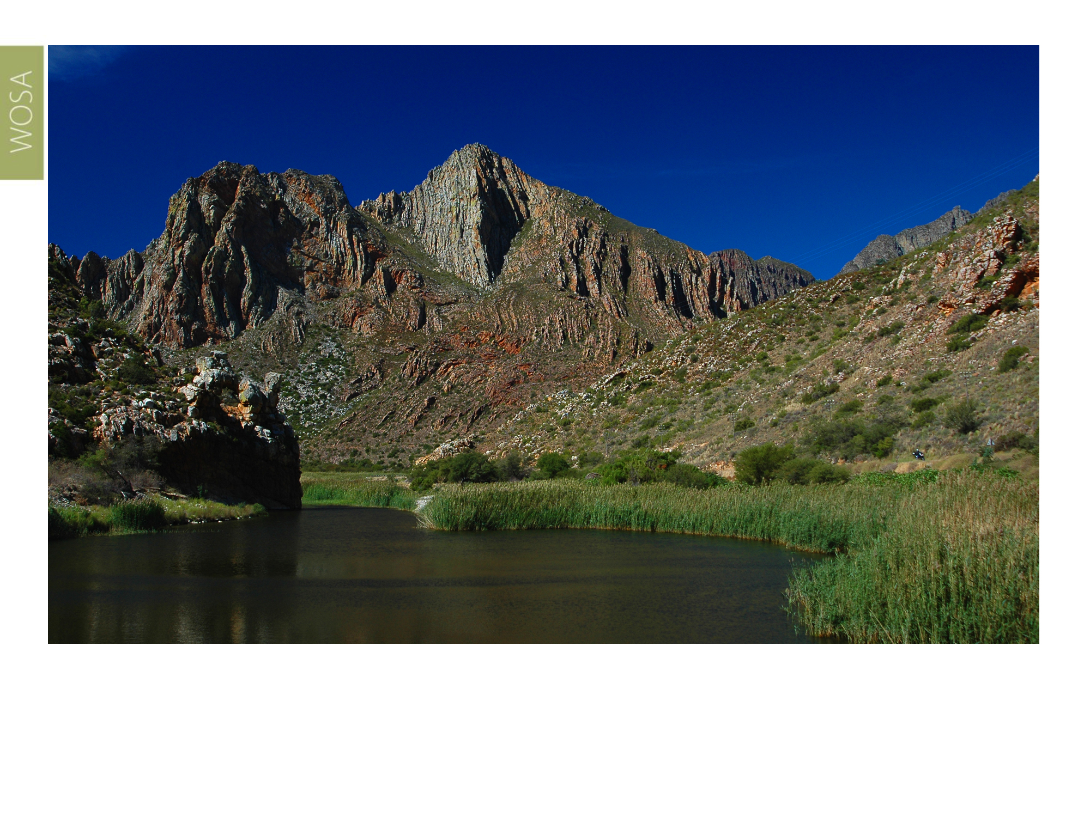
These mountains form part of the Cape fold belt and consist mainly of Table Mountain sandstone, while most of the Klein Karoo forms part of the Bokkeveld shale grouping, with good water retention and high nutrient properties.
Klein Karoo

Slide 16
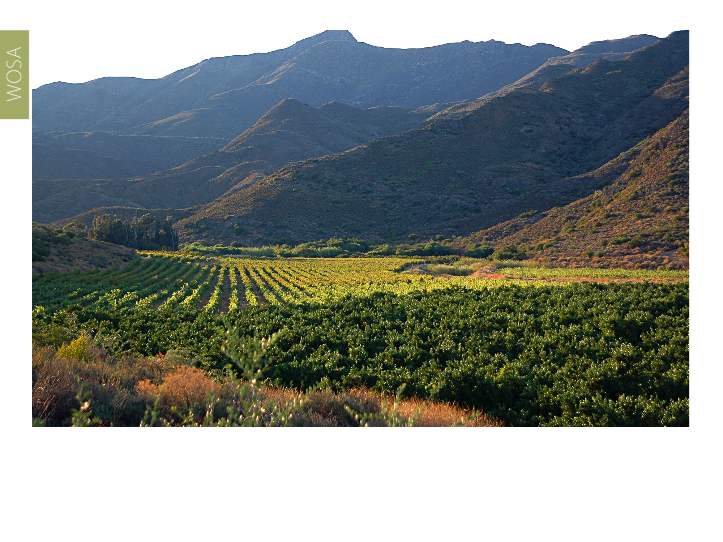
Viticulture takes place as plantings in finger-like kloofs, valleys and riverine sites in a rugged mountainous landscape.
Klein Karoo

Slide 17
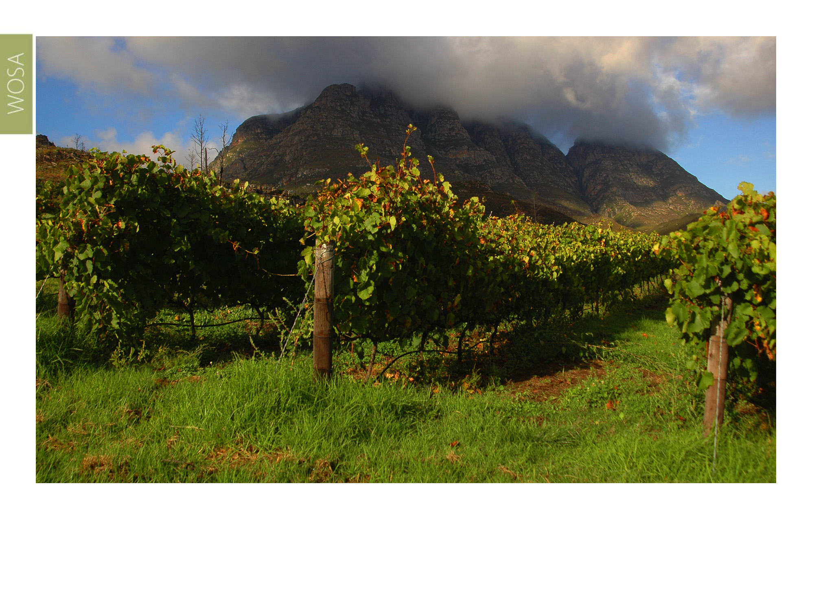
Traditionally plantings took place in valleys on deep alluvial soils derived from sandstone and/or shale, whereas more recent plantings take place on higher lying, cooler positions on skeletal, stony soils, mainly derived from shale.
Klein Karoo

Slide 18
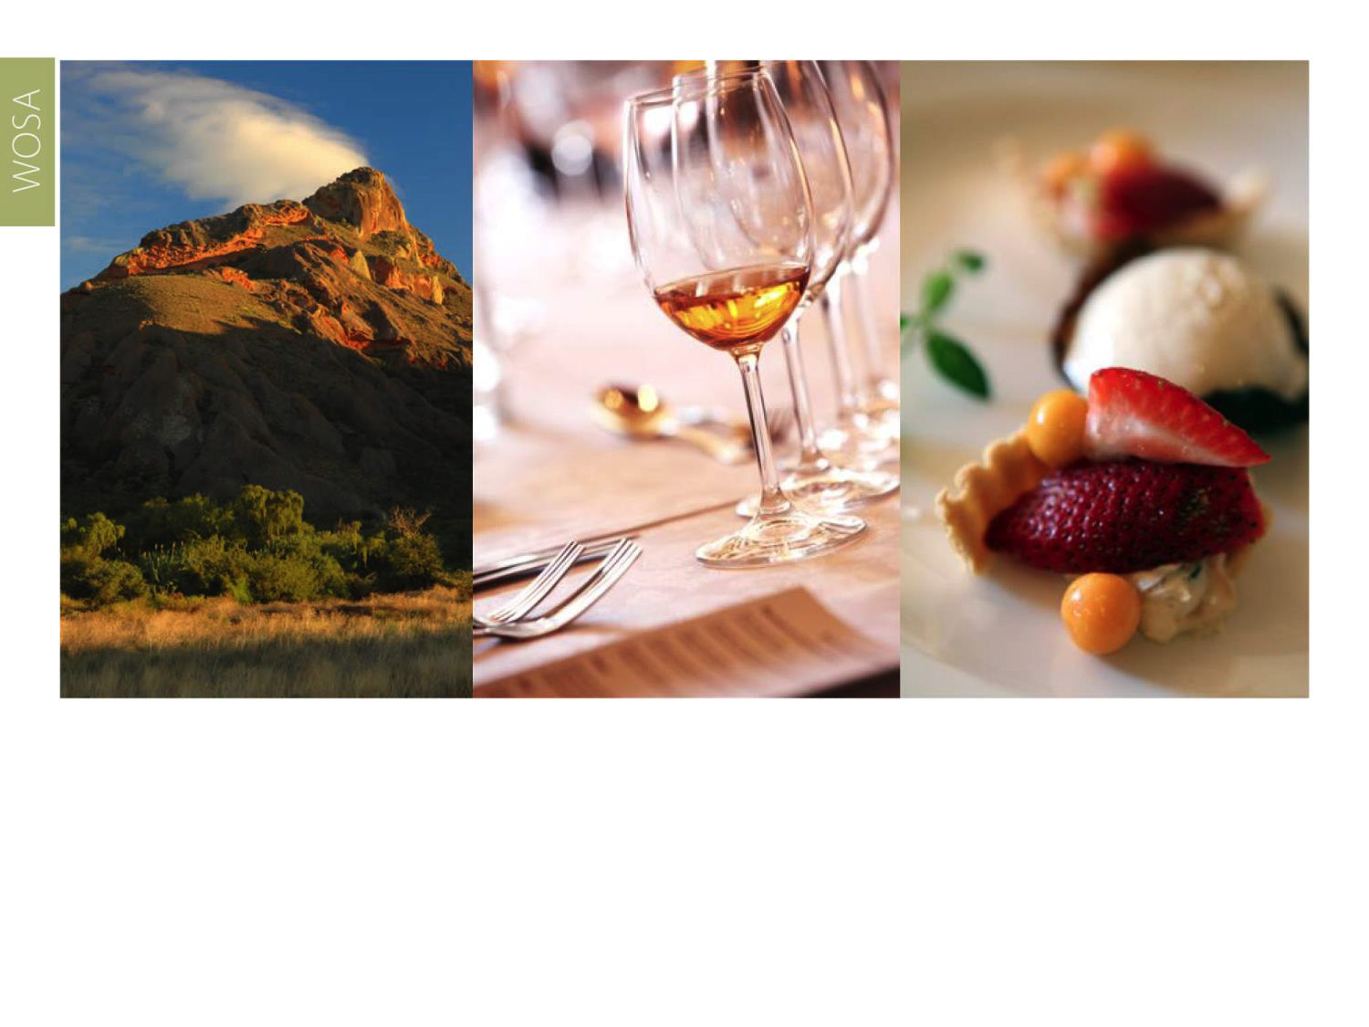
The area is known for its fortified wines, including Muscadel and Port-style wines, but new trends have emerged in the last decade.
Klein Karoo

Slide 19
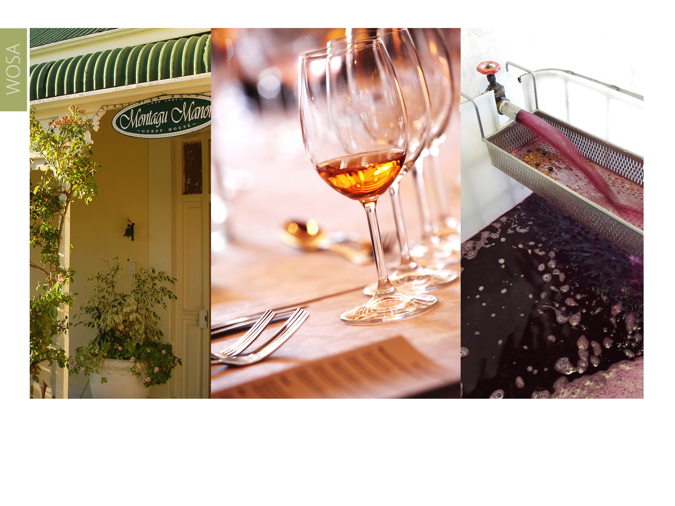
Montagu, the ‘gateway’ to the Klein Karoo, nestles in the far western corner of the Klein Karoo. The area now boasts some high quality Chenin Blanc and Cabernet Sauvignon vineyards and wines.
Klein Karoo

Slide 20
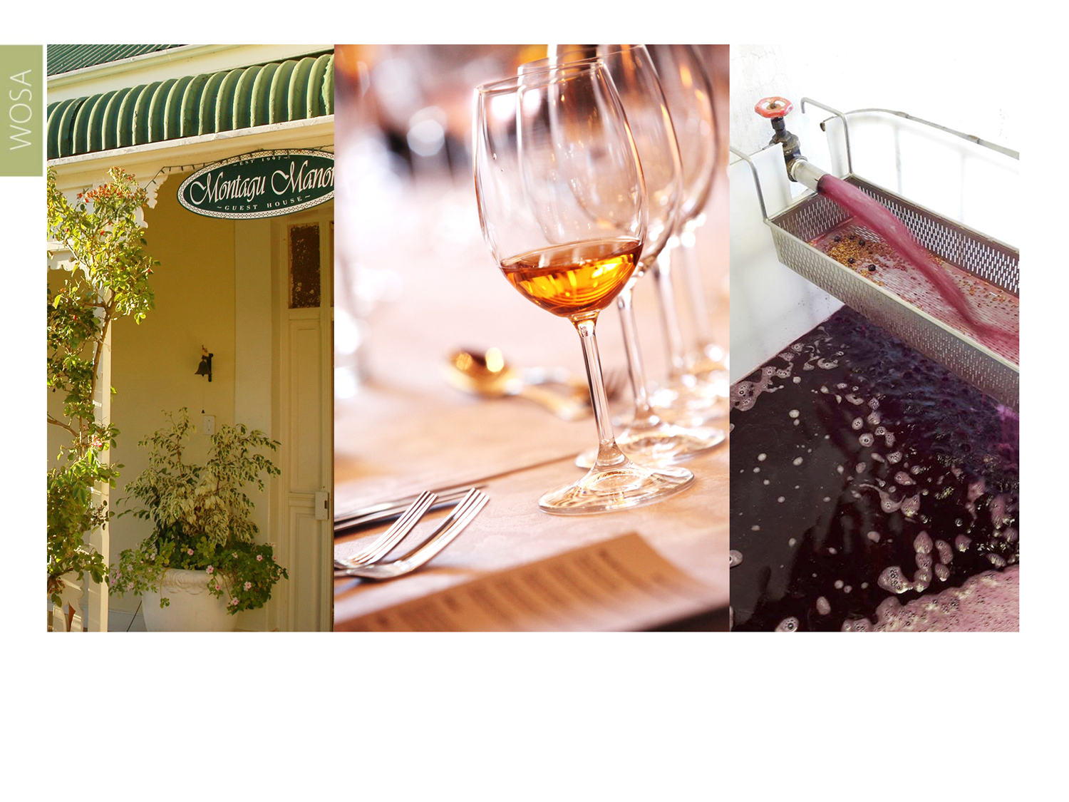
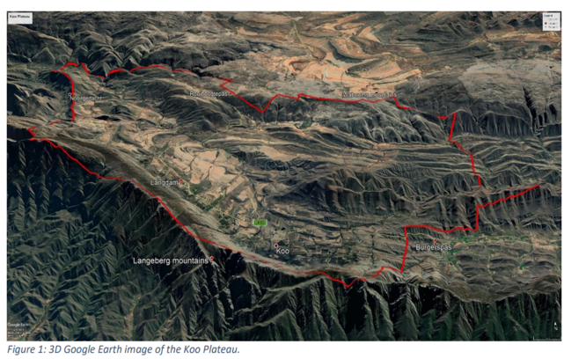
The high-altitude Koo Plateau ward is a unique mountain basin in one of the coldest areas in the Western Cape. Snowfall in the basin in winter is a common occurrence, as well as frost in lower-lying positions.
Klein Karoo

Slide 21
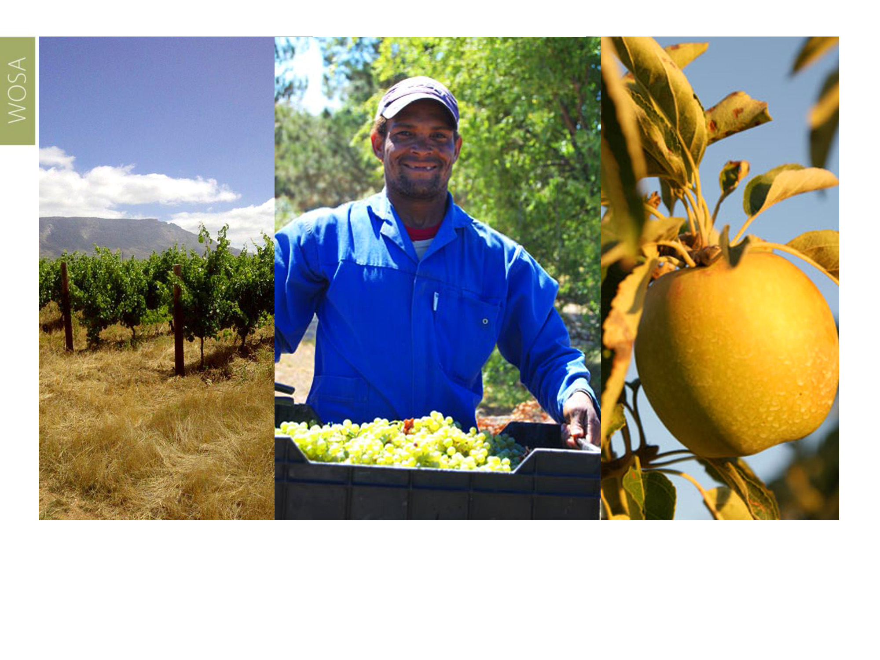
Moving eastward along the R62 you will find the cool-climate Tradouw Highlands ward on a plateau overlooking the Langeberg mountains. Export apples and pears are produced here alongside Sauvignon Blanc and Shiraz.
Klein Karoo

Slide 22
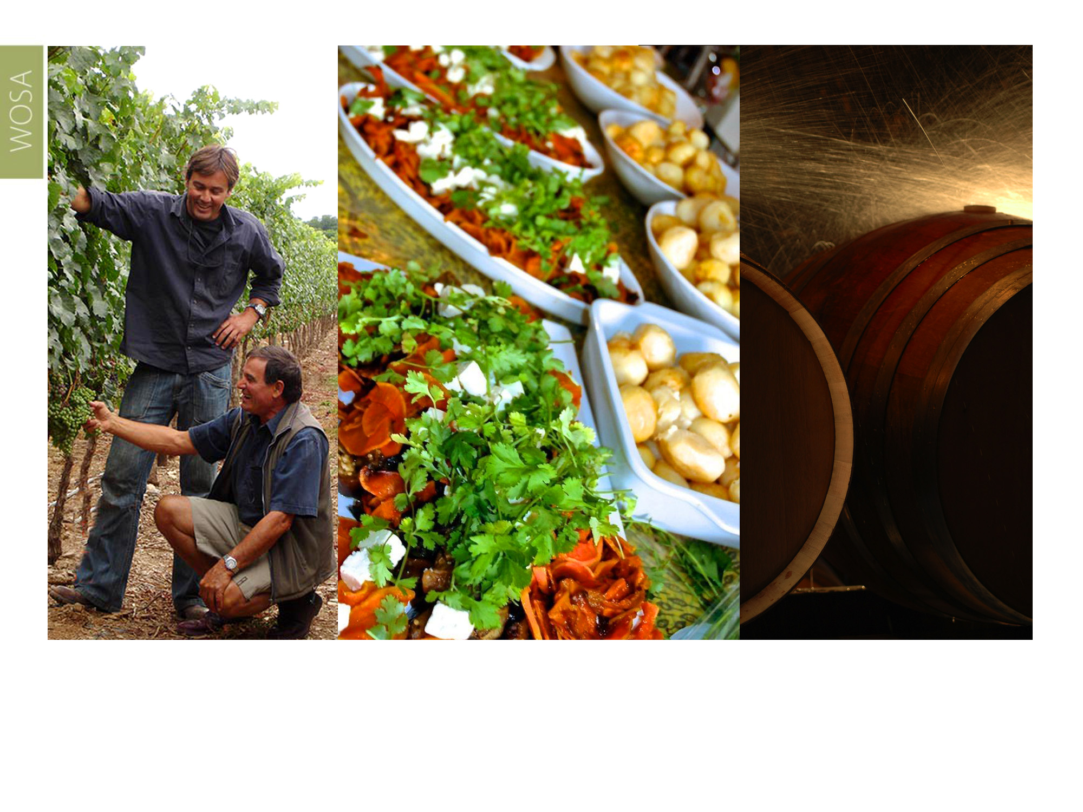
Closer to the town of Barrydale is another ward, Tradouw. Low night temperatures allow for the crafting of premium wines, especially Chardonnay and Cabernet Franc.
Klein Karoo

Slide 23
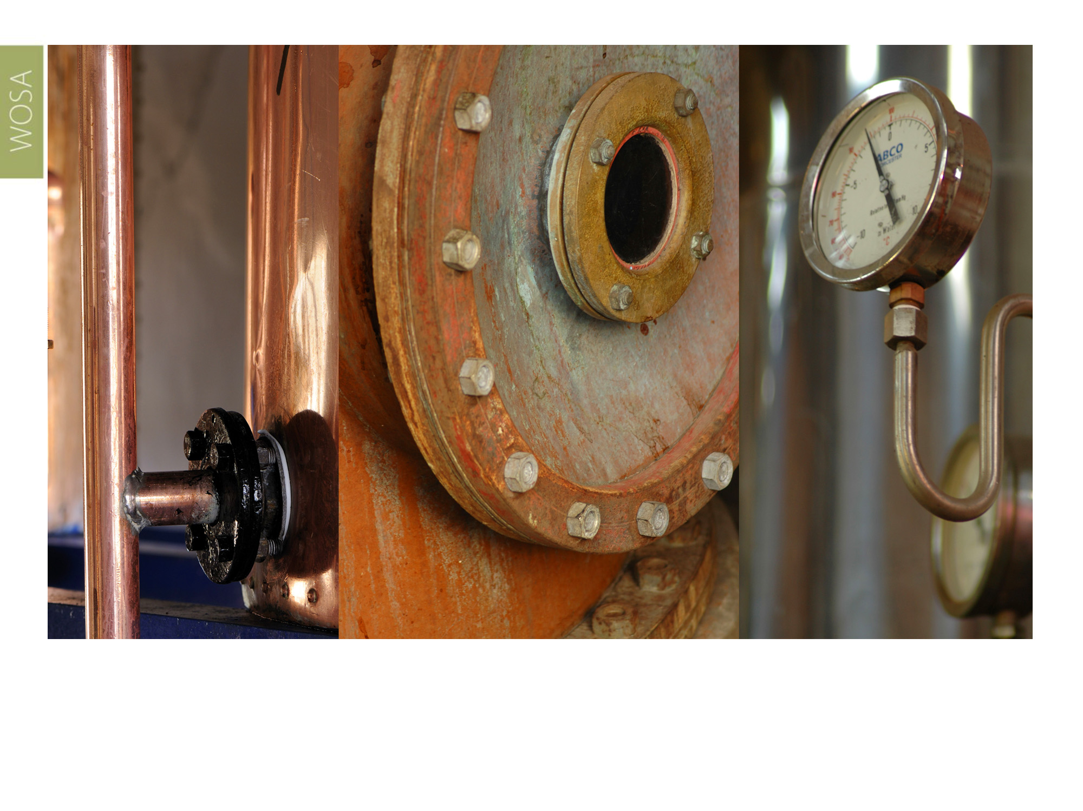
To add to the diversity of the Klein Karoo, the region is also known for its award-winning potstill brandies and other distilled products. Barrydale and Ladismith are renowned for their world-class brandies.
Klein Karoo

Slide 24
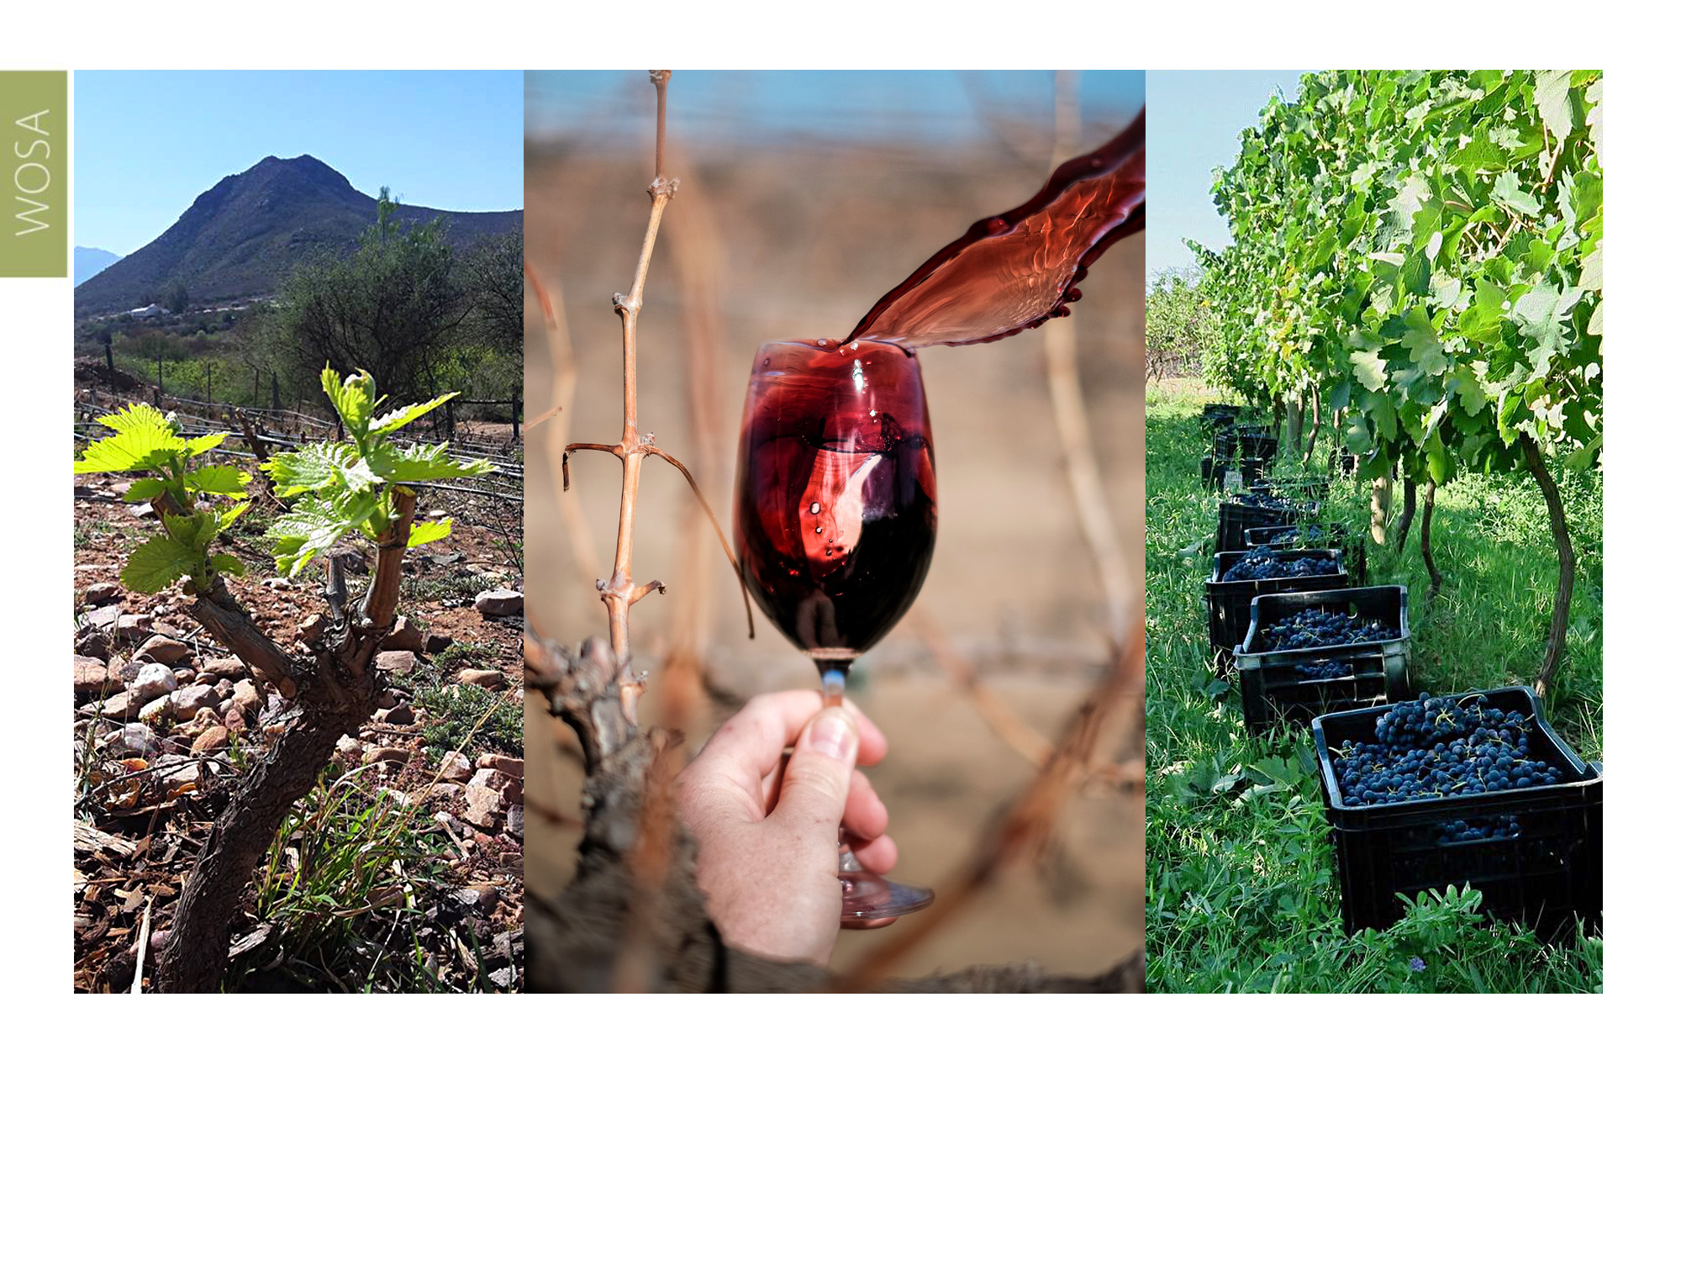
Calitzdorp has a dry, continental climate, with many similarities to the climate of the Douro Valley in Portugal with its warm days and cool nights. Here you’ll find plantings of Touriga Nacional, Tinta Barocca and other Portuguese grape varieties. Excellent quality red and white wines are being made from these varieties, as well as some of South Africa’s most iconic port-style wines.
Klein Karoo

Slide 25
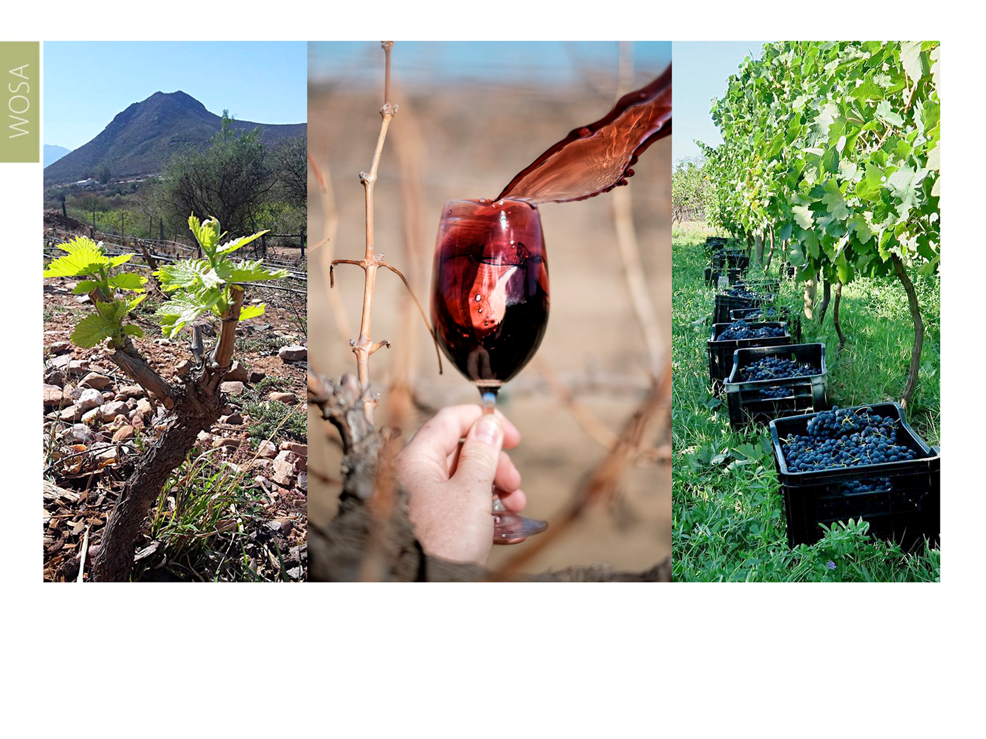
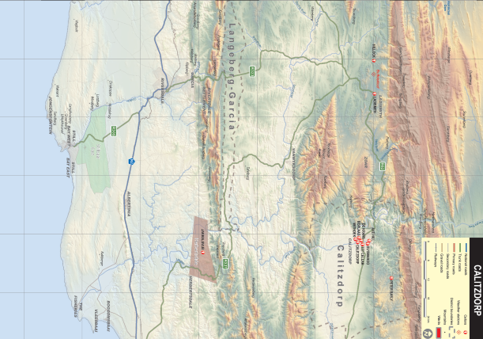
The Groenfontein ward is a higher lying foothill with a deep ravine landscape that borders on the Calitzdorp district to the north. The ward is situated 280–930 m above sea level with vineyards in valleys mostly 340–440 m above sea level. The geology is relatively homogeneous and consists of greywacke and shale.
Klein Karoo

Slide 26
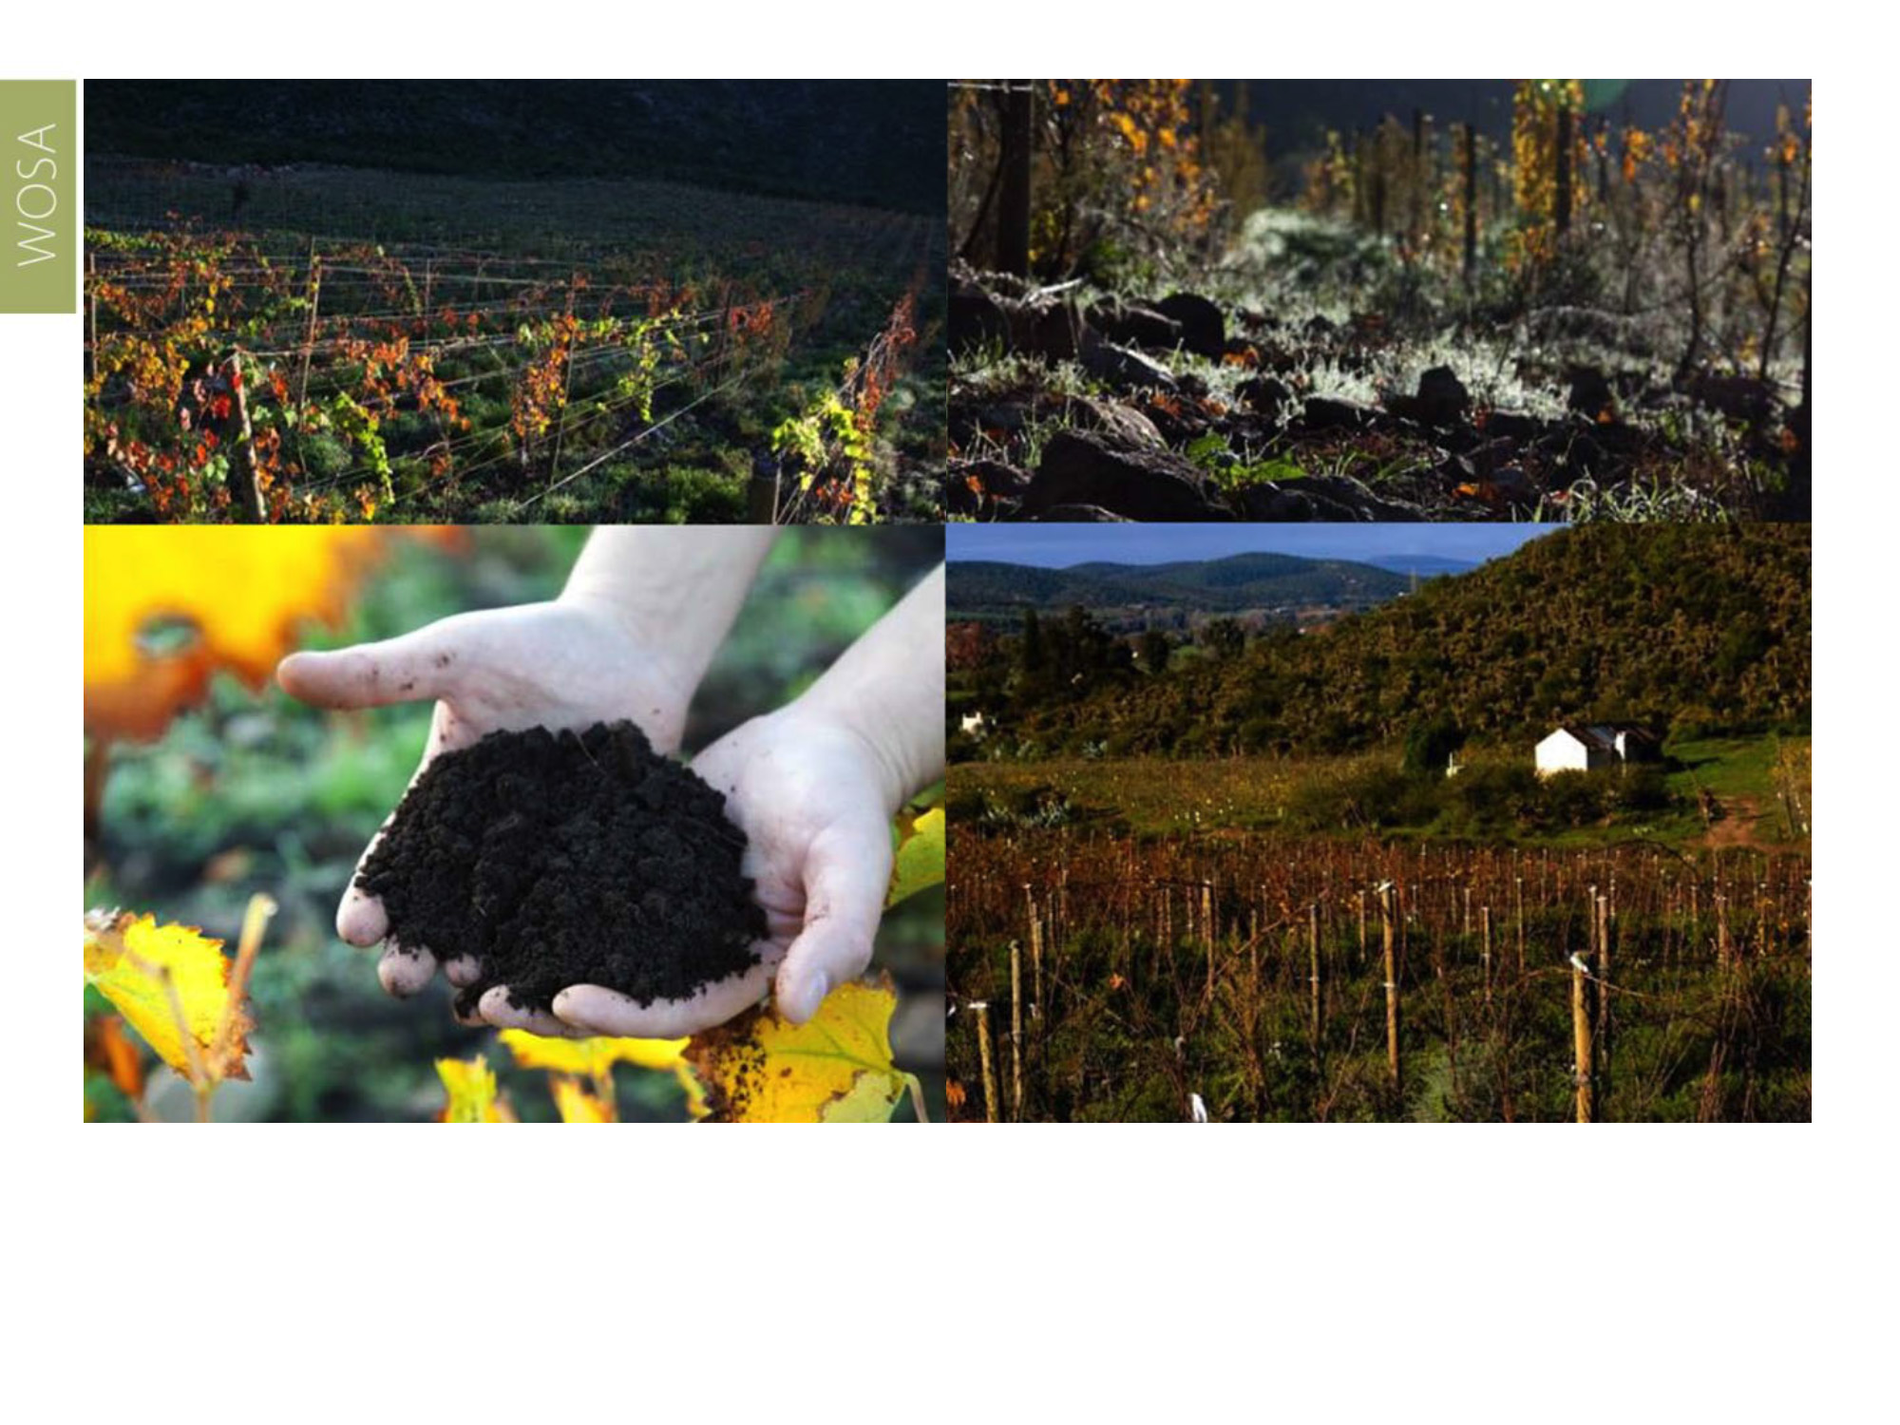
Vineyards in the Cango Valley ward near Oudtshoorn are planted on some of South Africa’s oldest soils, formed more than 540 million years ago. Here the focus is on Mediterranean varieties suited to the continental climate. These include Shiraz, Viognier, Mourvèdre, Grenache Noir and the native Pinotage.
Klein Karoo

Slide 27
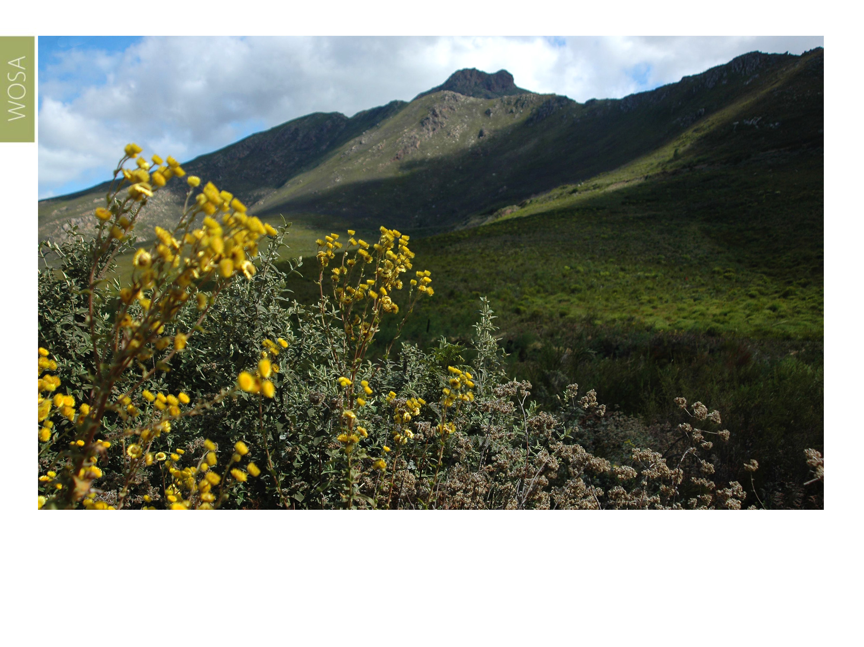
The Outeniqua ward, situated towards the southeast of the Klein Karoo region, is about 10 kilometres from the Indian Ocean and vineyards are planted between 500–700m above sea level on the northern side of the Outeniqua mountains. Soils here are a mixture of sandstone, clay and a high amount of iron ferricrete lower down the mountain.
Klein Karoo

Slide 28
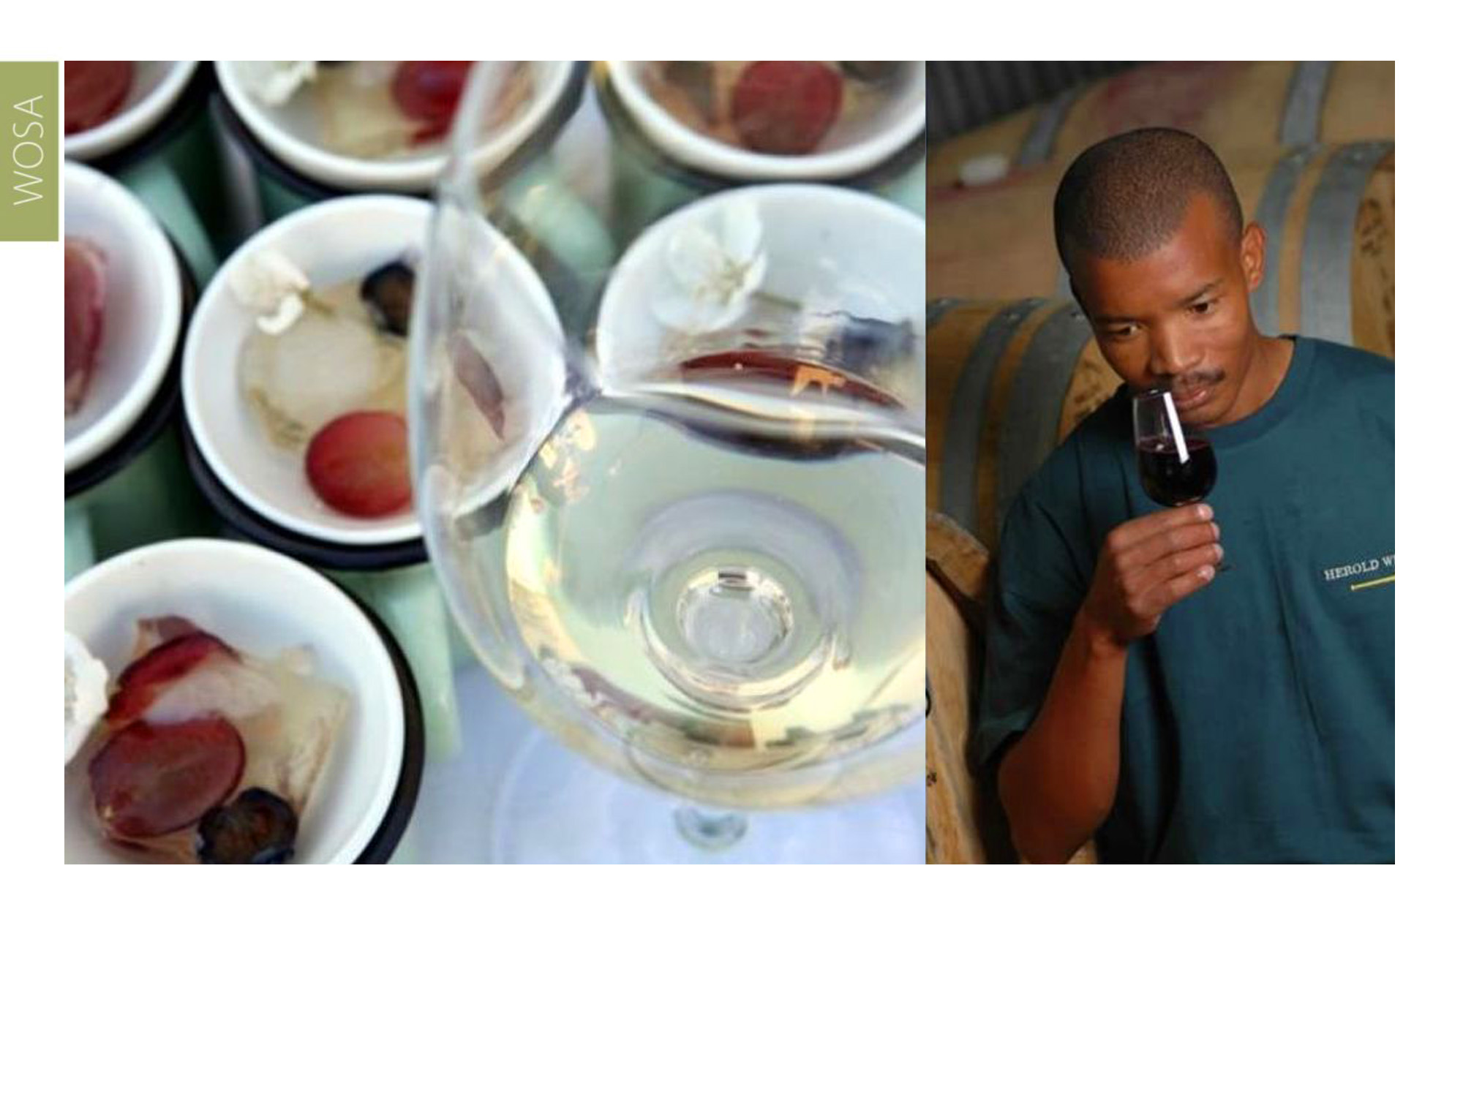
This area experiences a higher rainfall than the rest of the region and the cooler climate, which ensures very slow ripening, is perfect for Chardonnay, Riesling, Sauvignon Blanc and Pinot Noir. The wines from this relatively young ward, which is well-suited for producing cool-climate wines, already show great potential.
Klein Karoo

Slide 29
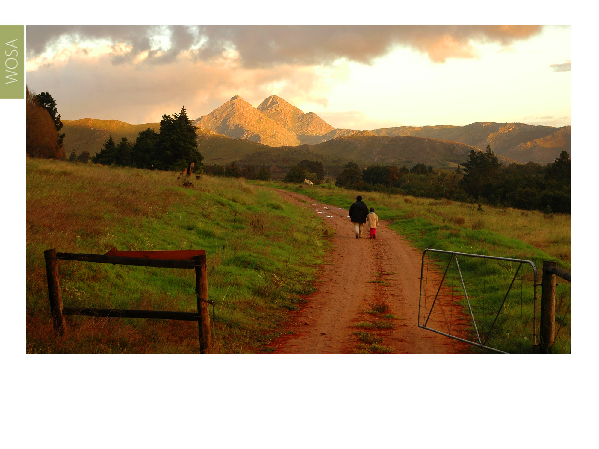
The images used in these presentations have been sourced from various producers, as well as industry and tourism bodies. These presentations are strictly for non-commercial, non-profit, educational purposes only and cannot be reproduced or transmitted in any form or by any means without written permission from Wines of South Africa (WoSA).

Slide 30
The Cape winelands, considered by many to be
the most beautiful in the world, have a network of
diverse and well-run wine routes, affording visitors
a varied and unforgettable experience.

Slide 31
THE END

